Slide 3
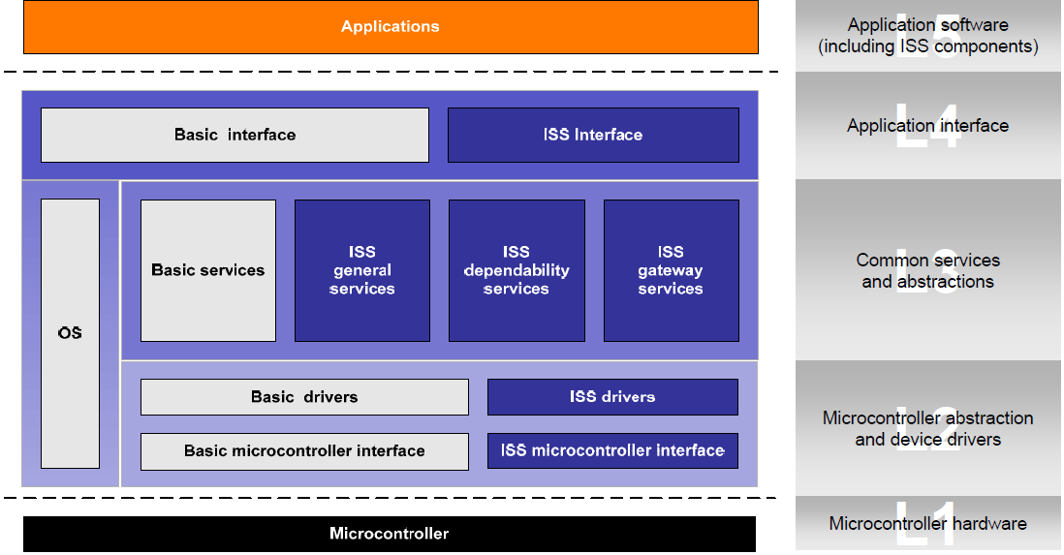

Slide 5
References
Jean-Charles Fabre, Marc-Olivier Killijian, François Taïani: Robustness of automotive applications using reflective computing: lessons learnt. SAC 2011: 230-235
Miruna Stoicescu, Jean-Charles Fabre, Matthieu Roy: Architecting Resilient Computing Systems: Overall Approach and Open Issues. SERENE 2011: 48-62
Jean-Charles Fabre, Marc-Olivier Killijian, Thomas Pareaud: Towards On-line Adaptation of Fault Tolerance Mechanisms. EDCC 2010: 45-54
Caroline Lu, Jean-Charles Fabre, Marc-Olivier Killijian: Robustness of Modular Multi-layered Software in the Automotive Domain: a Wrapping-based Approach. ETFA 2009: 1-8

Slide 6
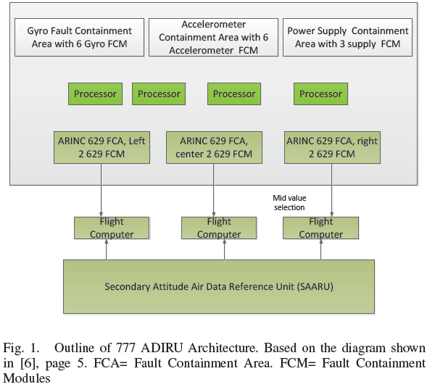
Case Study: Air Data Inertial Reference Unit (ADIRU)
Two ADIRU units: primary and secondary.
The primary ADIRU is divided into 4 Fault Containment Areas (FCA), with each FCA containing multiple Fault Containment Modules (FCM):
accelerometers (6 FCM),
gyros (6 FCM),
processors (4 FCM),
power supplies (3 FCM),
ARINC 629 bus (3 FCM).

Slide 7
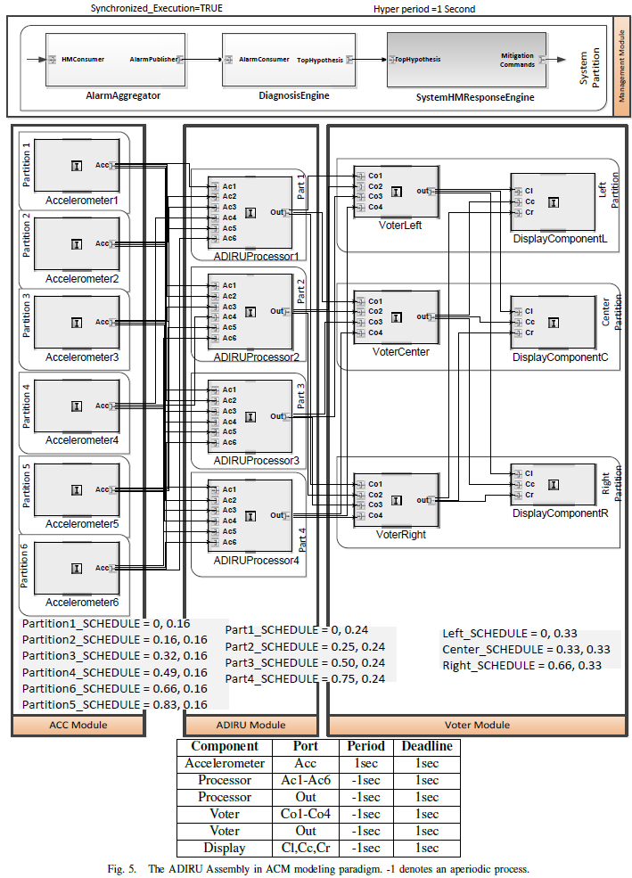

Slide 8
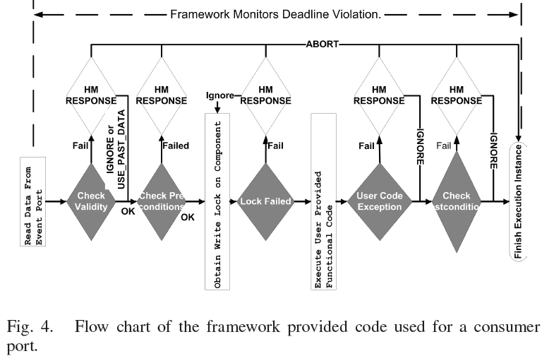
The shaded gray decision boxes are monitors. When an anomaly is detected by a monitor, it is always reported to the local component health manager. Deadline violation is always monitored in parallel by the underlying framework.
White boxes represent the possible mitigation actions taken by the local health manager.

Slide 9
SLHM
An aperiodic consumer, modeled with hierarchical timed state machine, receives the diagnosis results from the Diagnosis-Engine Component, and issues commands to other ARINC 653 processes (defined by ARINC-653)
RESET, STOP, CHECKPOINT and RESTORE
Notes:
Upon arrival of a new diagnosis result, the consumer triggers the state-machine

Slide 10
Experiments
Faults were artificially injected and turned on after a fixed number of iterations , including accelerometer 6 and 5
The Diagnoser was able to determine that the problem was caused by accelerometer 5 and shut it down.
Thereafter, the redundancy management algorithm in the ADIRU processor was able to reconfigure itself to use a different set of regression equations that did not use Accelerometer 5 or 6, and prevented a system-wide failure.

Slide 11
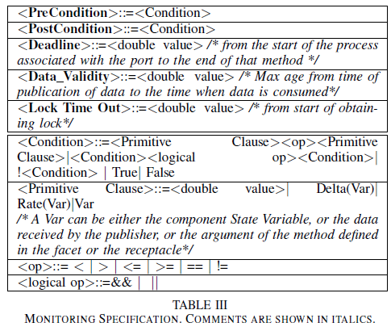
Monitoring Specification Language

Slide 12
1. Aggregator:
Integrates (collates) health information coming from components (typically in one hyperperiod)
2. Diagnoser:
Performs fault diagnosis, based on the fault propagation graph model
Ranks hypotheses
Component that appears in all hypotheses is chosen for mitigation
3. Response Engine:
–Issues mitigation actions to components based on diagnosis results
–Based on a state machine model that maps diagnostic results to mitigation actions

Slide 13
Safety Supervision Layer Fault Detection for Operating Systems in Fail-Safe Environments
Andreas Gerstinger

Slide 14
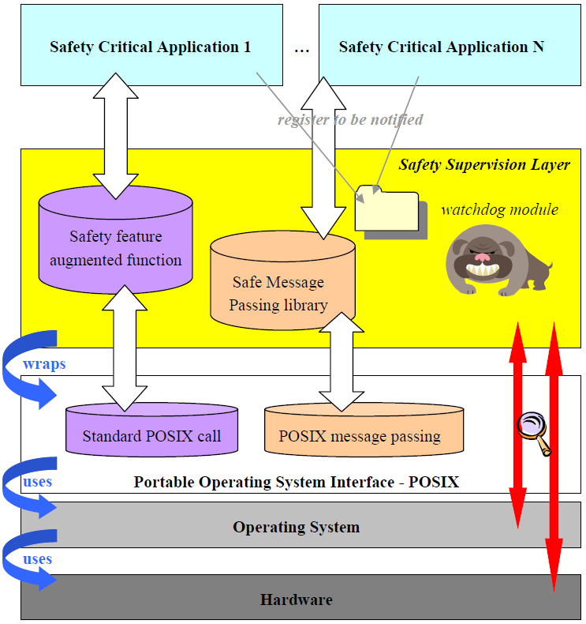

Slide 15
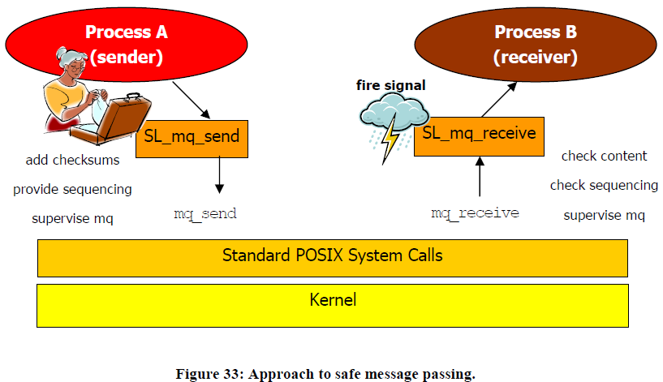
Safe POSIX Message Passing

Slide 16
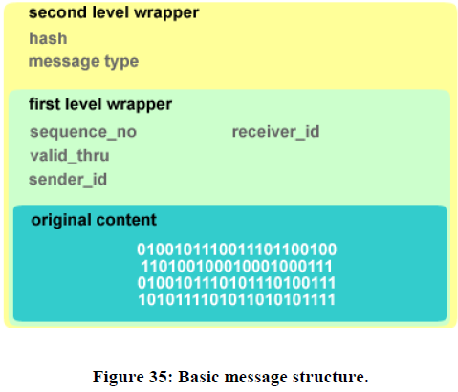

Slide 18
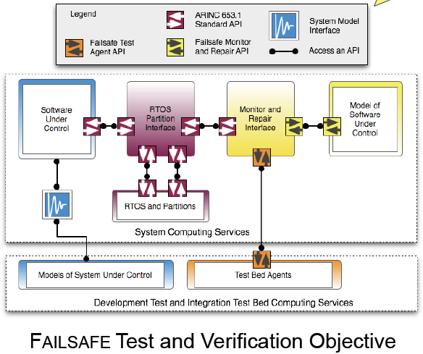

Slide 19
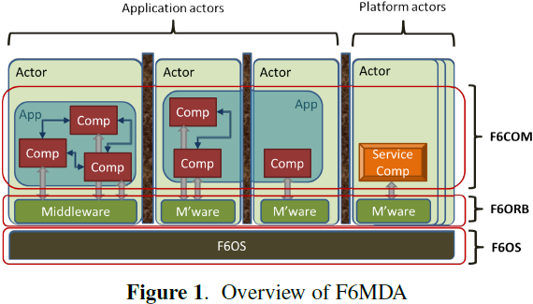
F6MDA
(i) F6OS, an operating system that provides core abstractions for concurrency, synchronization, resource management, and secure communications;
(ii) F6ORB, a middleware layer that implements the essential communication services for the distributed system;
(iii) F6COM, a component model that defines how components are built and how applications are constructed from components. Components are grouped into actors, which are temporally and spatially isolated from each other, and may be distributed and replicated across nodes. Platform actors provide system-level services.
Notes:
Application actors form applications; one application may be split across multiple application actors, potentially on different nodes and modules.

Slide 20
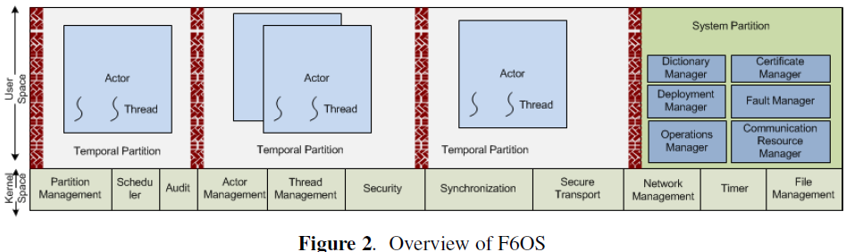
F6OS
An ARINC-653 compliant RTOS based on TDMA scheduling of temporal partitions
Actor: OS process with separate address space

Slide 21
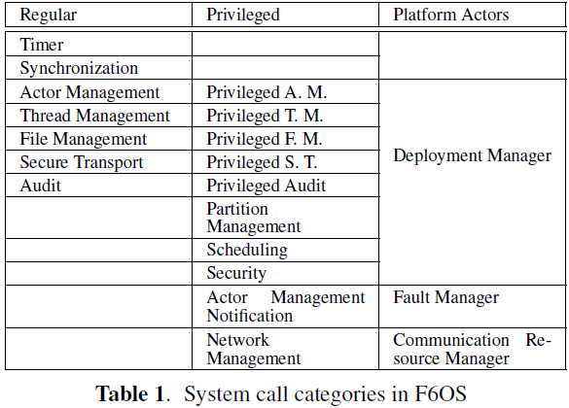

Slide 22
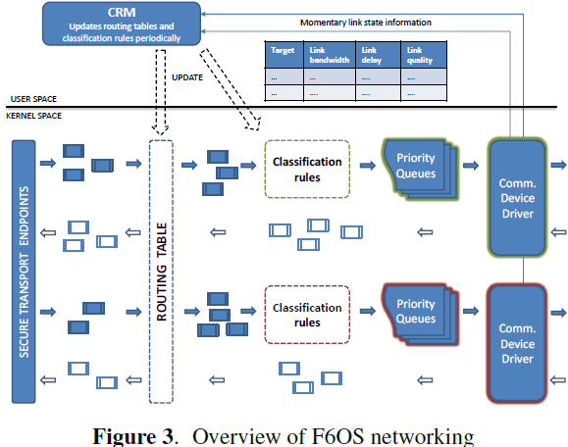
F6OS networking layer supports three use cases: transmit, receive, and forward.
The routing table, which is periodically refreshed by the CRM, determines the network device for the transmit and forward cases and the read endpoint for the receive case.
The classification rules are maintained per mounted network device.
Based on these rules, F6OS inserts each message into the priority queue that conforms to the QoS class of the message.

Slide 23
two communication mechanisms between
actors, described in the next two subsections:
Synchronous and asynchronous point-to-point communication,
built using a subset of the Common Object Request
Broker Architecture (CORBA) standard [9]. This interaction
is mostly suitable for control or management aspects, where
a request is often accompanied by a response.
Anonymous publish/subscribe, built using a subset of the
Data Distribution Service (DDS) standard [10].

Slide 24
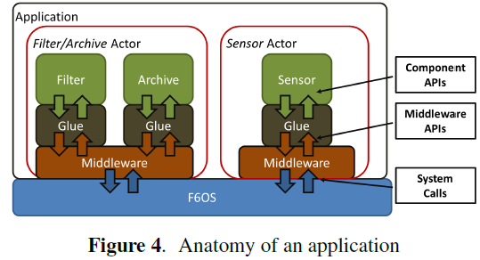
F6ORB

Slide 25
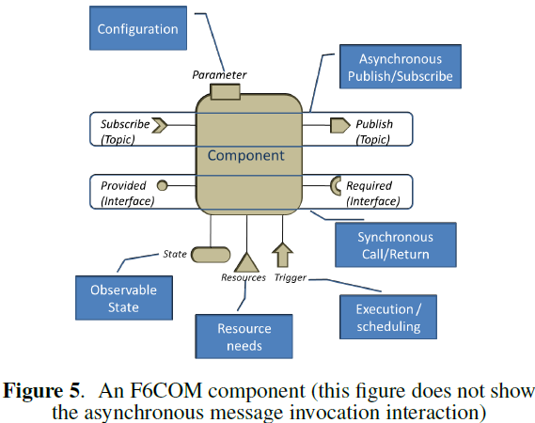

Slide 26
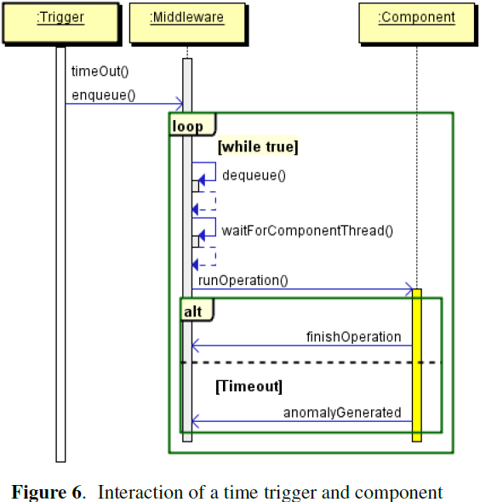

Slide 27
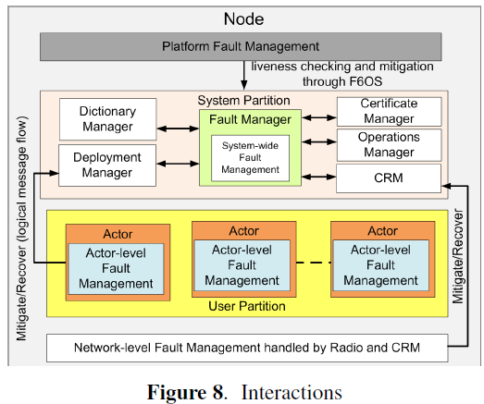

Slide 28
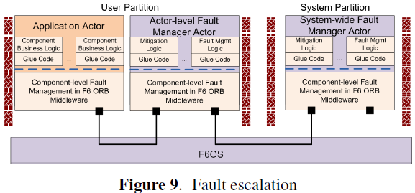

Slide 29
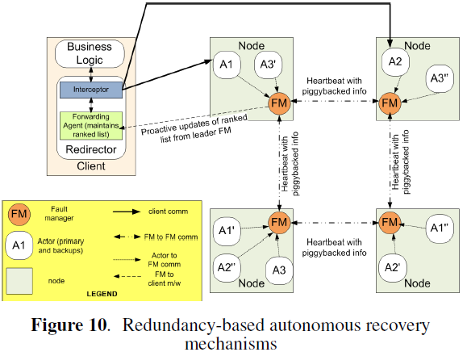

Slide 30
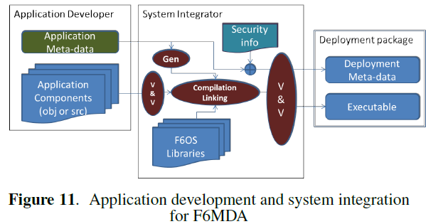

Slide 31
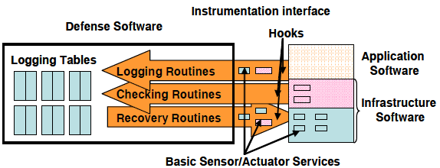

Slide 32
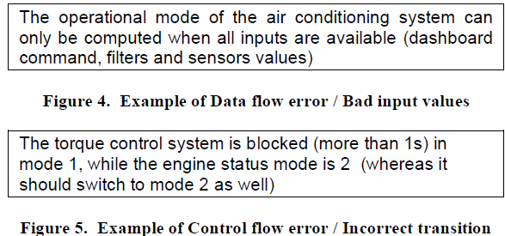
Development Steps

Slide 33
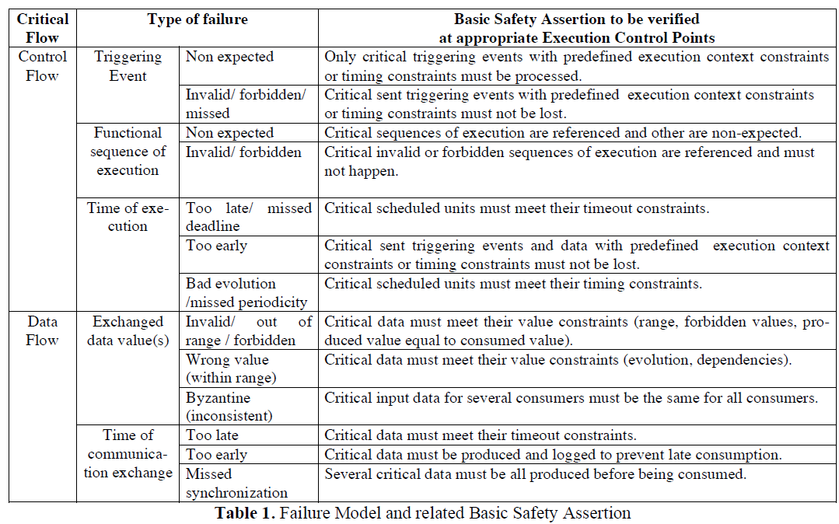

Slide 34
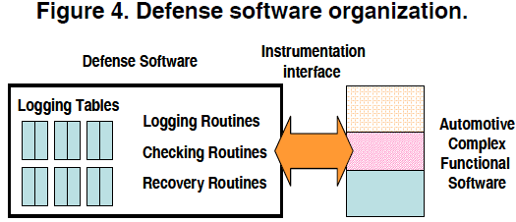
Defensive Software
Logging tables and three types of services
(i) information logging (“logging routines”),
(ii) error detection (“checking routines”), and
(iii) error recovery (“recovery routines”).

Slide 35
Bracket Tables
The execution trace from OS viewpoint:
when a critical task starts execution, an “opening-bracket table” entry is filled basically with the task identifier and a timestamp. The “closing-bracket-table” stores the same type of information, when the task ends
The execution trace from application viewpoint:
when a critical application-level function starts and ends.
The control event trace:
when an activation event (that impacts directly or indirectly the activation of a task) happens, an “opening-bracket-table” entry is filled basically with parameters that characterize the event, the current running task identifier, and a timestamp. The “closing-bracket-table” stores the same type of information, when the termination event occurs.
The data event trace:
when a critical data is written, an “opening-bracket-table” entry is filled basically with the data, the function identifier that produces the data, the task identifier in which it runs and a timestamp. The “closing-bracket-table” stores the same type of information, when the data is read.

Slide 36
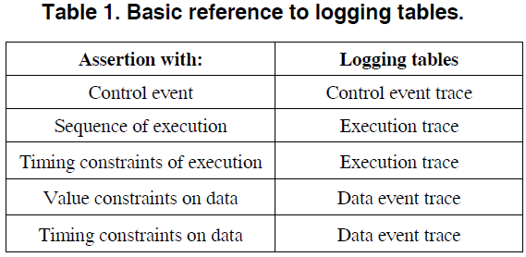

Slide 37
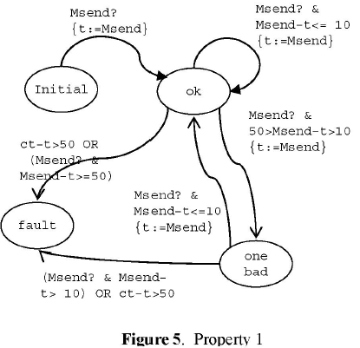
State Machine for Property Monitoring
3 properties:
1. The Sensor is deemed faulty if the time between any two measurements sent to Estimator is greater than 50 ms, or if the time between two consecutive measurements is greater than 10 ms.
2. The Estimator is deemed faulty if it does not respond
to a request from Flight Control within 10 ms.
3. The Flight Control is deemed faulty if it does not remove a value from the channel E within 100 ms after it was sent.
FSM for monitoring property 1 is shown. (The other 2 are omitted.)

Slide 38
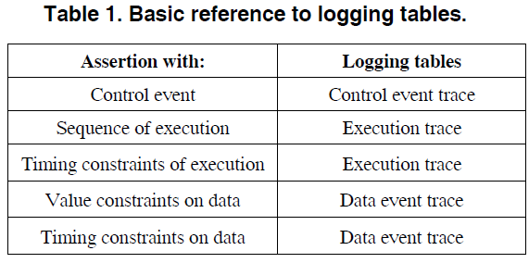
Error Detection Strategy

Slide 39
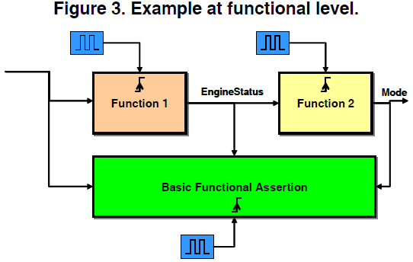
Unwanted System Events (USE)
“The system is blocked (more than 1 second) in mode A, while the engine status is equal to 2, whereas it should switch to mode B”.

Slide 41
BUILDING A DEPENDABLE OPERATING SYSTEM: FAULT TOLERANCE IN MINIX 3
JORRIT NIEK HERDER, PhD Thesis 2010

Slide 42
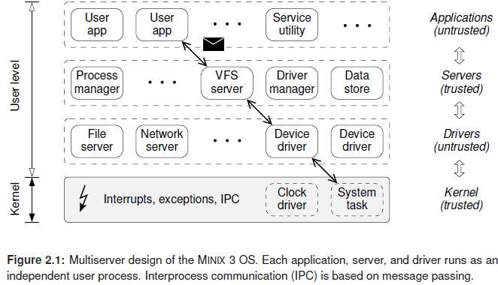

Slide 43
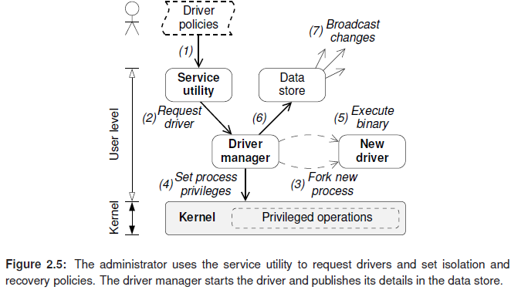
Notes:
The procedure to start a driver is a strictly defined sequence of events, as illustrated
in Fig. 2.5. The steps are as follows: (1) the administrator decides on a driver
policy and calls the service utility, which performs some sanity checks and (2) forwards
the request to the driver manager. The driver manager verifies that the caller is authorized and stores the policy. Then the driver is started by the driver manager: (3)
it creates a new process for the driver and looks up the IPC endpoint that uniquely
identifies the process, (4) it informs other parts of the system about the new process
and the privileges granted by the isolation policy, and (5) it executes the driver
binary once the process has been properly isolated. Finally, (6) the details of the
newly started driver are published in the data store and (7) dependent components
are notified about the new system configuration.

Slide 44
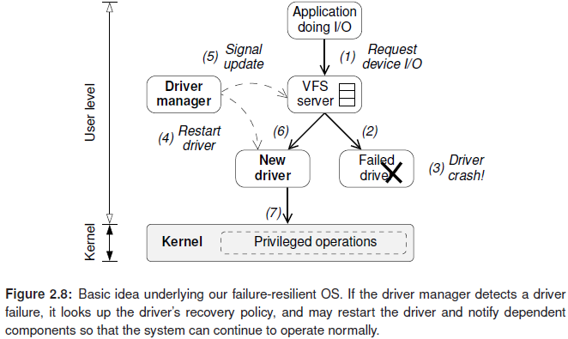

Slide 45
Chapter 3 Fault Isolation
3.1.1 The Principle of Least Authority

Slide 46
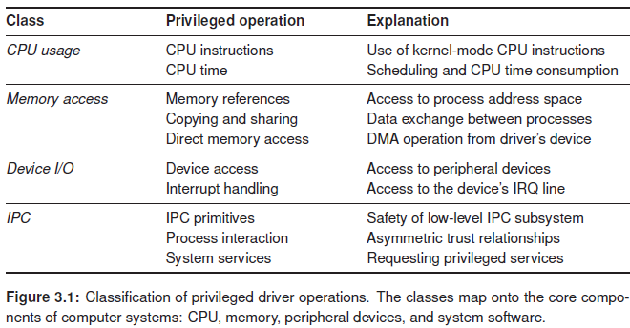

Slide 48
PROVIDING APPLICATION-AWARE RELIABILITY THROUGH OS/HYPERVISOR-LEVEL TECHNIQUES, Long Wang, PhD Thesis UIUC 2010
Operating systems and hypervisors enable the collection and extraction of rich information on application and system execution characteristics. This thesis describes a Reliability MicroKernel (RMK) architecture, which provides an infrastructure that enables the design and deployment of software modules for providing application-aware error detection and recovery. The purpose of the RMK is to provide an automatic approach for low-latency crash/hang detection and rapid recovery via checkpoint. We first demonstrate how the RMK works in a native system and then enhance the RMK to work in VMs. In a native system, the RMK is installed as a device driver, while in a virtualized system, the RMK is both installed as a device driver in VMs and deployed as a hypercall (which is like a system call) in a hypervisor. Our approach is transparent to applications and VMs, i.e., it is not required to modify or recompile the kernel source code in a native system or in a VM.
The implemented RMK modules include OS/application crash detection, system hang detection, and transparent checkpoint. Traditionally, an external hardware watchdog is used to force a system reboot whenever the watchdog is not reset within a predefined timeout interval. The detection latency might be significant because the timeout interval for resetting the watchdog timer is usually a matter of seconds to reduce false alarms. The approach in this thesis enables low-latency OS-hang detection (within hundreds of milliseconds or less) by measuring the count of instructions executed between two consecutive context switches and checking if the count exceeds a predefined threshold value.
The RMK is enhanced to support virtualized environments. Specifically, we present the description, implementation, and experimental assessment of VM-μCheckpoint, a VM checkpointing framework to protect both the guest OS and applications against runtime errors. Compared with the existing VM checkpoint techniques, our VM-μCheckpoint has small overhead and rapid recovery, handles non-fail-stop errors, and runs at high frequency (tens of checkpoints per second) to reduce the recomputation necessary when recovering a VM from a failure. The key point of VM-μCheckpoint is that we do an incremental checkpoint by considering the whole memory of the protected VM as part of the checkpoint.
The RMK prototype has been implemented in both Linux and Windows systems on a Pentium 4 processor and is also implemented in the Xen VMM.
Notes:
A number of techniques have been proposed for low-latency and
low-cost hang detection, e.g., SHD in RMK [15], KHM [16], hardware watchdog [17], and Linux
NMI watchdog [18]. These techniques are either not systematically evaluated ([16], [17], [18]) or
are evaluated through injection of memory or processor errors ([15]) in the program execution.

Slide 49
Reliability MicroKernel (RMK)
Implemented as an OS device driver. Includes 3 modules:
OS/application crash detection,
system hang detection,
transparent checkpoint.

Slide 50
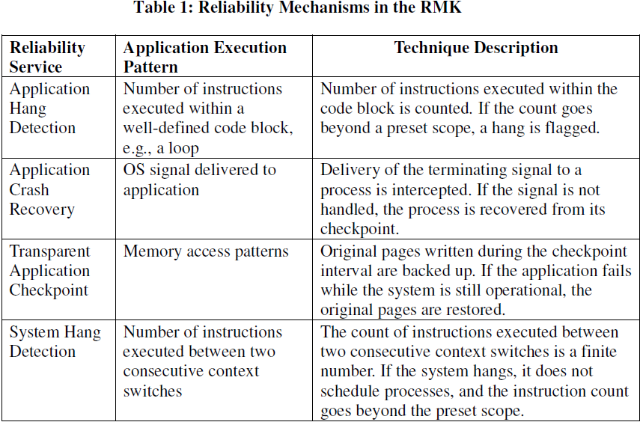

Slide 51
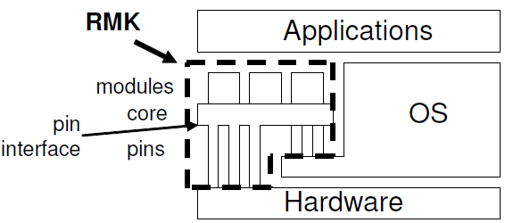

Slide 52
System-Level RMK Interface

Slide 53
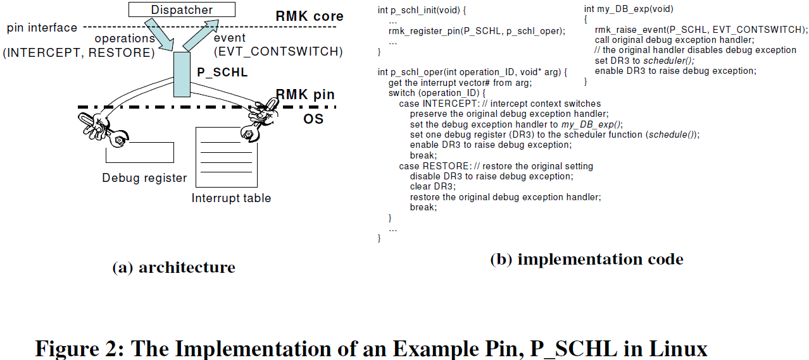

Slide 54
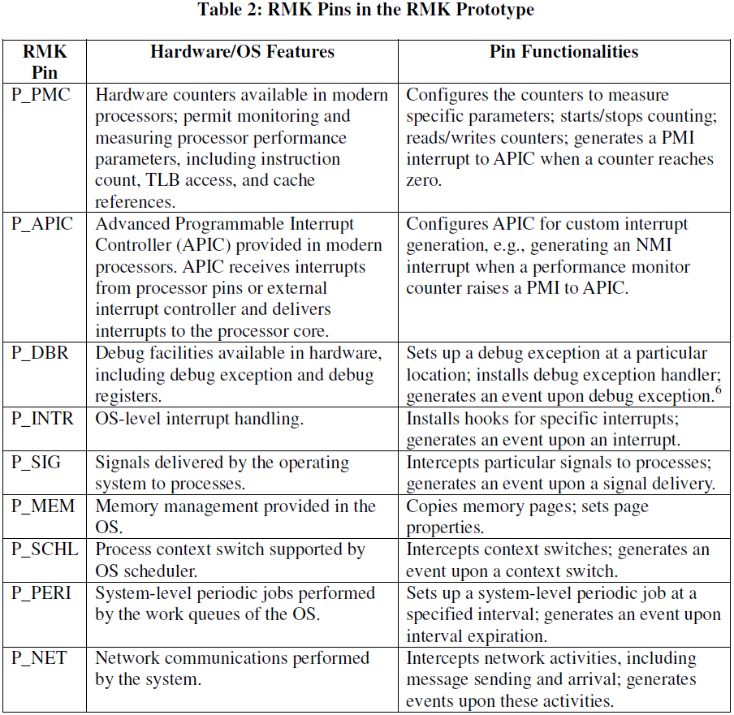
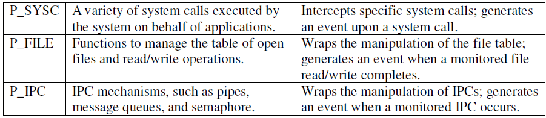

Slide 55
Application-Level RMK Interface

Slide 56
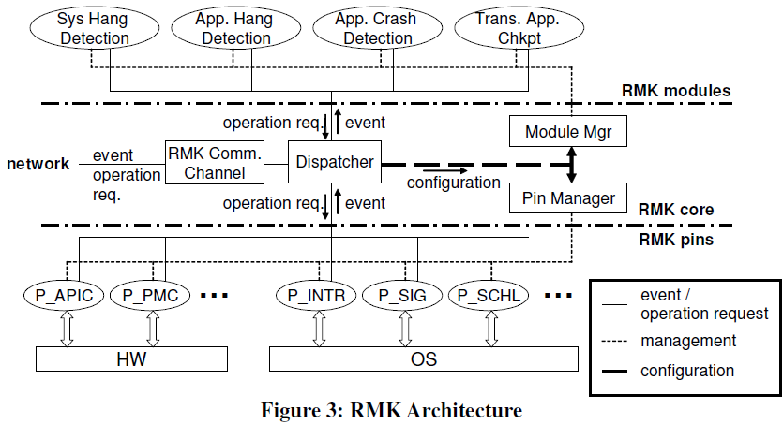

Slide 57
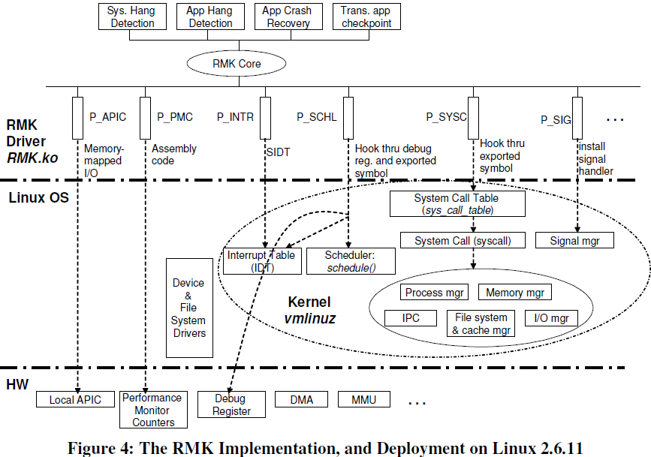

Slide 58
Pin Interface
Two sets
A set of operations the pin can perform.
In the case of P_SCHL, operations include INTERCEPT, and RESTORE
A set of events the pin can produce given a trigger condition (a process context switch in the case of P_SCHL pin).
In the case of P_SCHL, the event set includes EVT_CONTSWITCH

Slide 59
3.1. System Hang Detection Module (SHD)
Fault model for a system hang is that an OS in a hang state does not relinquish the processor and does not schedule any processes.
Detection steps:
1. Use OS-level counters to separately track instructions executed by the application processes and OS.
2. Observe periodically (e.g., on each context switch) whether the instruction count in each counter changes between the consecutive readings.
3. If the contents of the OS counter continue to change and the counters associated with application processes are frozen, this is a clear indication of a system hang.

Slide 60
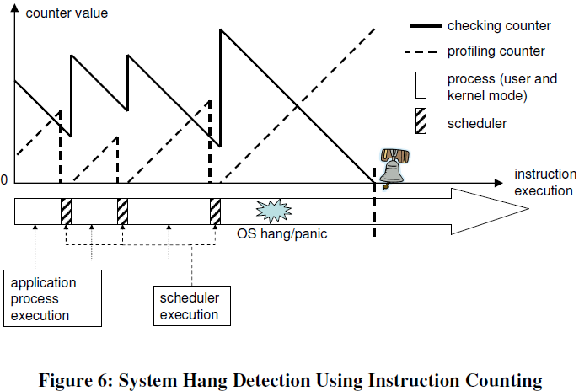
Profiling counter keeps track of the number of instructions executed in the current time slice by a process
Checking counter maintains a “check value” that is the running count of the maximum number of instructions executed in a time-slice, and obtained over a sliding window of about 50 time-slices.

Slide 61
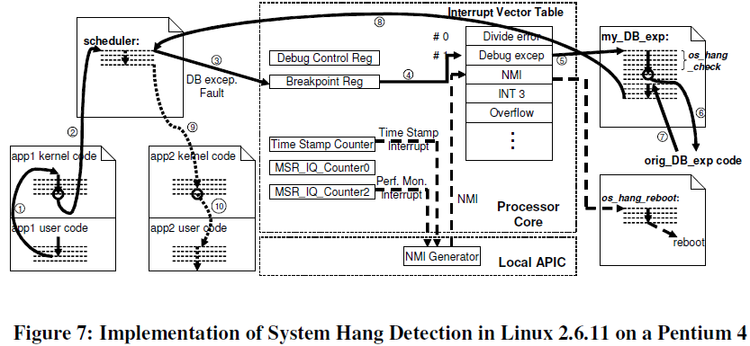
Notes:
An application process, app1, enters the kernel mode to execute a system call, or to handle an
interrupt (step 1 in Figure 7). After the kernel mode processing completes, the Linux system
checks whether the time-slice assigned to app1 is used up. If the time-slice is used up, the system
invokes the scheduler (step 2). In a typical case, when the RMK is not deployed, the scheduler completes the context switch, and transfers the control to the next application process, app2 (step
9, the dotted line).
When the RMK is deployed, the scheduler entry point (the address of the first instruction of the
scheduler) is written into a breakpoint register, and the debug control register is properly
configured so that whenever the instruction at the breakpoint is to be executed, a debug exception
fault is raised by the processor (steps 3, 4). The DB exception interrupt handler registered in the
system’s interrupt vector table points to the custom exception handler, my_DB_exp (step 5). This
exception handler performs three tasks: (i) it reads, and sets hardware counters in the processor,
and executes the detection algorithm (i.e., os_hang_check()); (ii) it calls the original debug
exception handler (step 6); and (iii) it writes the scheduler entry point into the breakpoint register,
configures the debug control register to enable repeating the same processing on the next context
switch, and then returns to the scheduler11 (step 8). The third task is required because the original
debug exception handler by default disables the debug exception. After returning to the scheduler, the typical processing resumes (the next process is scheduled) (steps 9, 10). Steps 3-8 are
provided in the P_SCHL pin with the support of P_DBR, and P_INTR.
Two performance counters, MSR_IQ_Counter0 and MSR_IQ_Counter2, are used for profiling
and checking, respectively. The Time Stamp Counter is used to handle processor-halt cases. When
a system hang occurs, MSR_IQ_Counter2 decrements to zero, and triggers a performance
monitor interrupt (PMI) into the NMI generator in the local APIC. The NMI generator raises the
NMI to the processor, where the interrupt is converted to the EVT_NMI event, and the registered
callback function, os_hang_reboot(), reboots the system. The corresponding control flow is
depicted by dashed lines in Figure 7.

Slide 62
3.2. Application Hang Detection Module (AHD)
Applications threads may hang due to incorrect function parameters, hardware faults, deadlock, or failed I/O.
The unit of monitoring is a code section, a block of code with a single entry.
The AHD keeps a logical counter for every thread running in a monitored code section. An array of counters monitor a multithreaded application,

Slide 63
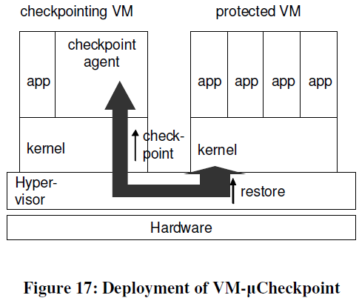

Slide 64
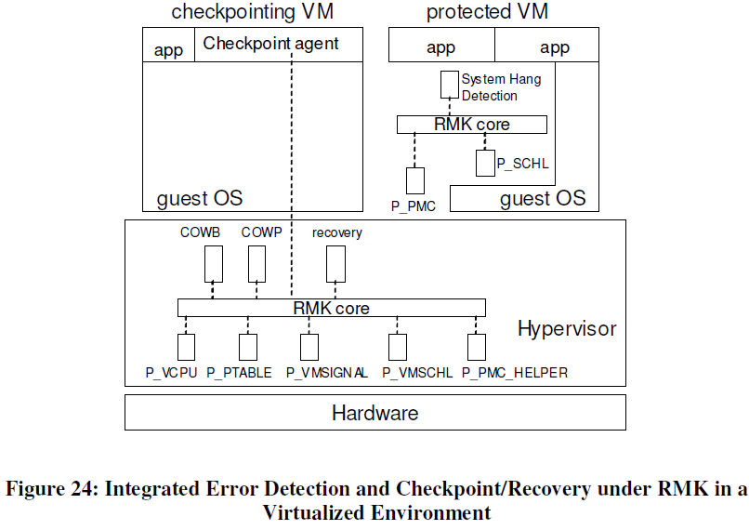

Slide 66
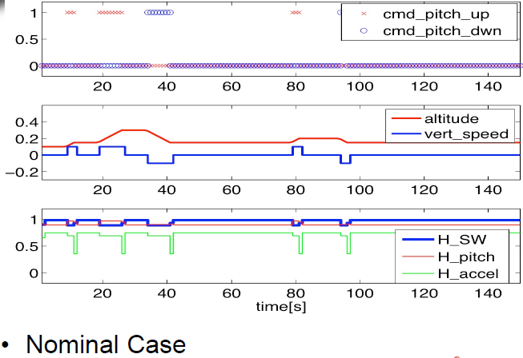
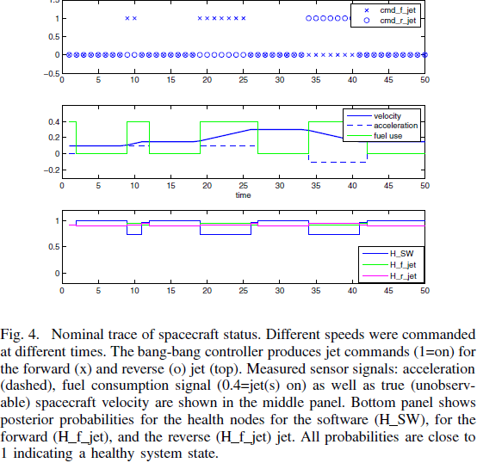
Notes:
commands to change velocity (top panel) result in firings of jets.
Middle panel: the measured velocity, acceleration, and fuel use
Bottom panel shows the posterior probability of the SSHM health nodes. Values close to 1 correspond to healthy software and components.

Slide 67
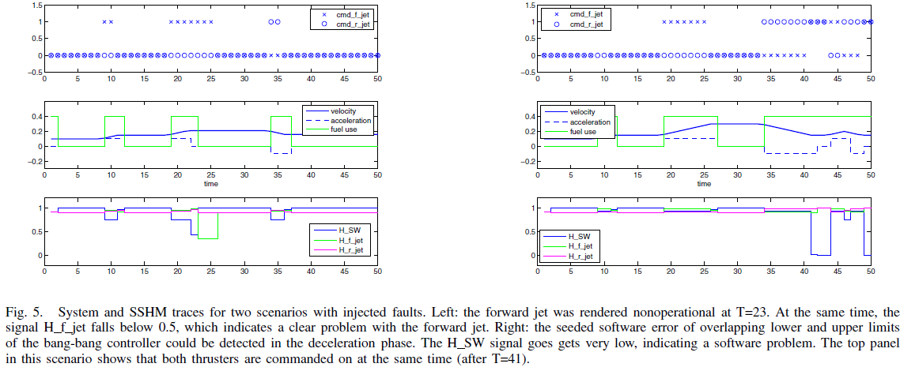
Notes:
In Figure 5, we look at two different failure traces. Here,
initially the same change in velocity as in Figure 4 is commanded:
commanded firing at around T = 8 and T = 18
causes measured acceleration and thus an increase in velocity.
The left trace is a situation where we measure no acceleration,
because a no change-velocity command had been
given. Initially, health nodes for the jets, the accelerometer, and
5For an overview see http://www.cs.ubc.ca/∼murphyk/Bayes/bnsoft.html.
0 5 10 15 20 25 30 35 40 45 50
−0.5
0
0.5
1
1.5
cmd_f_jet
cmd_r_jet
0 5 10 15 20 25 30 35 40 45 50
−0.2
0
0.2
0.4
time
velocity
acceleration
fuel use
0 5 10 15 20 25 30 35 40 45 50
0
0.5
1
H_SW
H_f_jet
H_r_jet
Fig. 4. Nominal trace of spacecraft status. Different speeds were commanded
at different times. The bang-bang controller produces jet commands (1=on) for
the forward (x) and reverse (o) jet (top). Measured sensor signals: acceleration
(dashed), fuel consumption signal (0.4=jet(s) on) as well as true (unobservable)
spacecraft velocity are shown in the middle panel. Bottom panel shows
posterior probabilities for the health nodes for the software (H SW), for the
forward (H f jet), and the reverse (H f jet) jet. All probabilities are close to
1 indicating a healthy system state.
the software all show high-probability values for “healthy”.
However, after T = 23, no acceleration can be measured,
despite the fact that the jet is still supposed to fire (Cmd f jet
is set). Two things could have caused this: the accelerometer
could have produced bad measurements, the jet might not
be working, or (the unmodeled situation that) the spacecraft
has landed and jet firing does not produce any acceleration.
The Bayesian network can easily disambiguate these scenarios
and comes up with the (injected) most probable fault—an
nonoperational (e.g., iced-up) jet—because it detects that no
fuel has been consumed. The health node for the jet (H f jet)
clearly indicates this situation.
In Figure 5 (right), we again start out with the original
healthy scenario. However, around T = 42, no acceleration
is measured. However, fuel is consumed, and both thrusters
should fire (Cmd f jet and Cmd r jet are set). This situation
indicates that the thrusters are operational, but their actions
cancel out. As the health model reflects the fact that at no
time both thrusters should be operational, reasoning reveals
that there is a software problem. In fact, the injected failure
is a mess-up of the thresholds of the bang-bang controller.

Slide 68
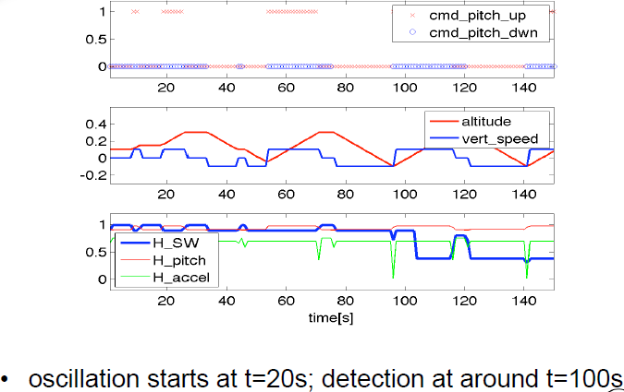

Slide 69
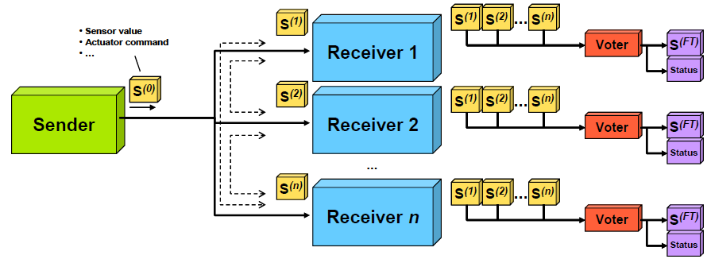
Agreement Protocol
Signed Message Protocol for handling Byzantine faults

